Slide 1
Olist Store Analysis Report
Biggest Departmental Store

Slide 2
CONTENTS OF THIS REPORT
Summary | OverView of the whole Sales report of Olist Store.
Excel | Dashboard made on Excel for data sorting and Power query for data cleaning.
Power Bi | Advance version of dashboard with better visualisation.
Tableau | Dashboard presented with modern visual effects.
SQL | Query written using SQL for the E-Commerce data set.
Project Overyview | Details, uses and benefits of the tools used in the project.

Slide 3
Olist Store Analysis Report Summary
Objective:
To analyze store data to uncover actionable insights on sales trends, product performance, customer behavior, and operational efficiency. The goal is to support strategic decision-making using data analytics and visualization tools.
Tools Used:
SQL: Used to extract, clean, and manipulate data from relational databases.
Excel: Performed initial data exploration, transformation, and ad-hoc calculations.
Power BI: Built interactive dashboards for real-time insights into sales, profit, and regional performance.
Tableau: Created visually compelling visualizations to identify trends and outliers in customer behavior and product performance.
Key Insights:
Sales & Revenue Analysis:
Identified peak sales months and underperforming periods.
Recognized high-revenue product categories and least contributing items.
Store Performance:
Compared store performance across regions using sales per square foot.
Flagged underperforming stores for further operational review.
Customer Trends:
Segmented customers based on purchase frequency and spending behavior.
Noted preferences for specific product categories in different regions.
Inventory Optimization:
Detected stock-out situations and overstock issues.
Recommended inventory adjustments based on demand patterns.
Business Impact:
Enhanced strategic decision-making with real-time dashboards.
Increased visibility into operations and performance at all store levels.
Enabled proactive inventory management and improved customer satisfaction.
Provided a scalable reporting framework for future analytics initiatives.

Slide 4
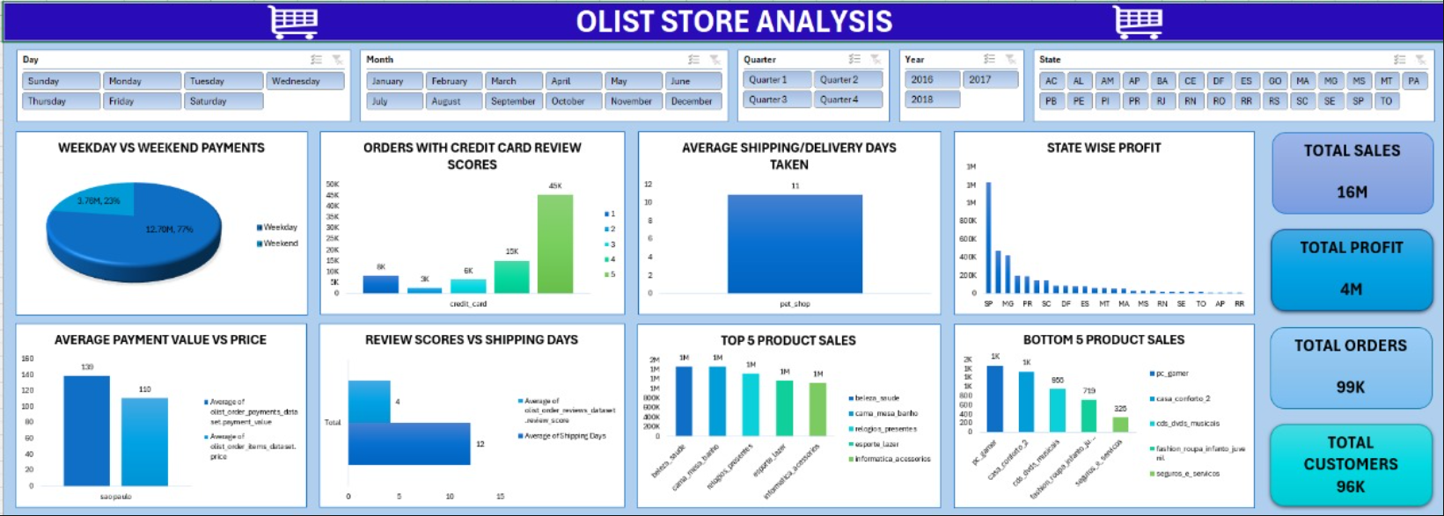
Excel – Olist Store Dashboard

Slide 5
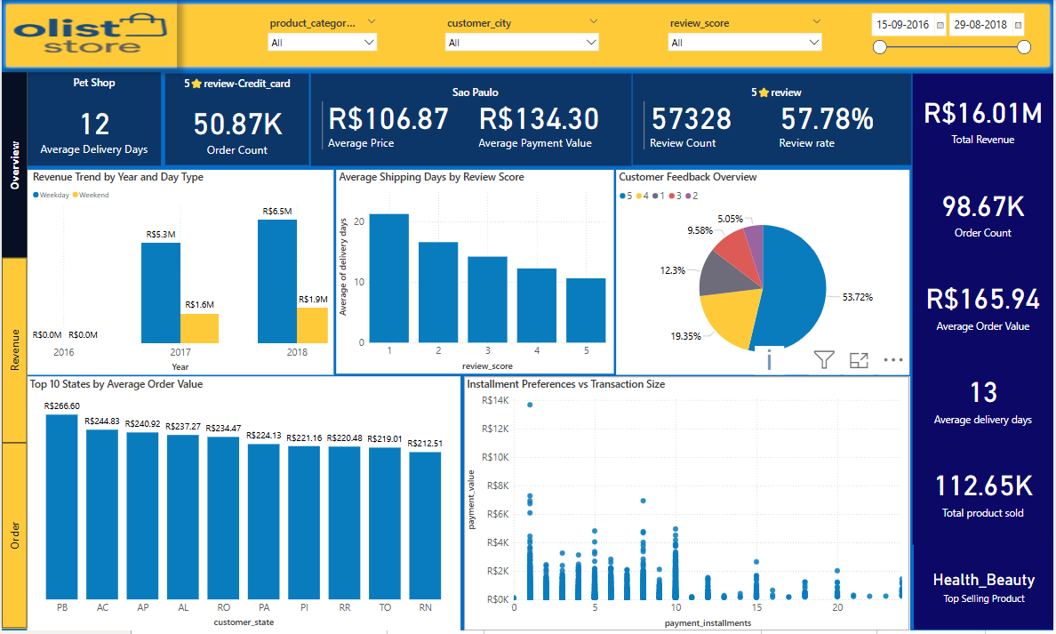
Power Bi – Olist Store Dashboard (Overview)

Slide 6
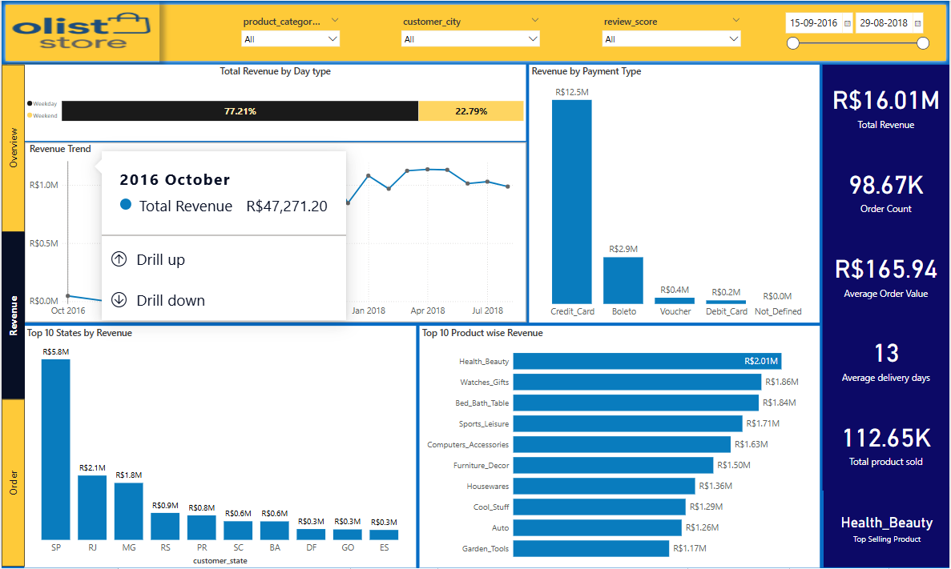
Power Bi – Olist Store Dashboard (Revenue)

Slide 7
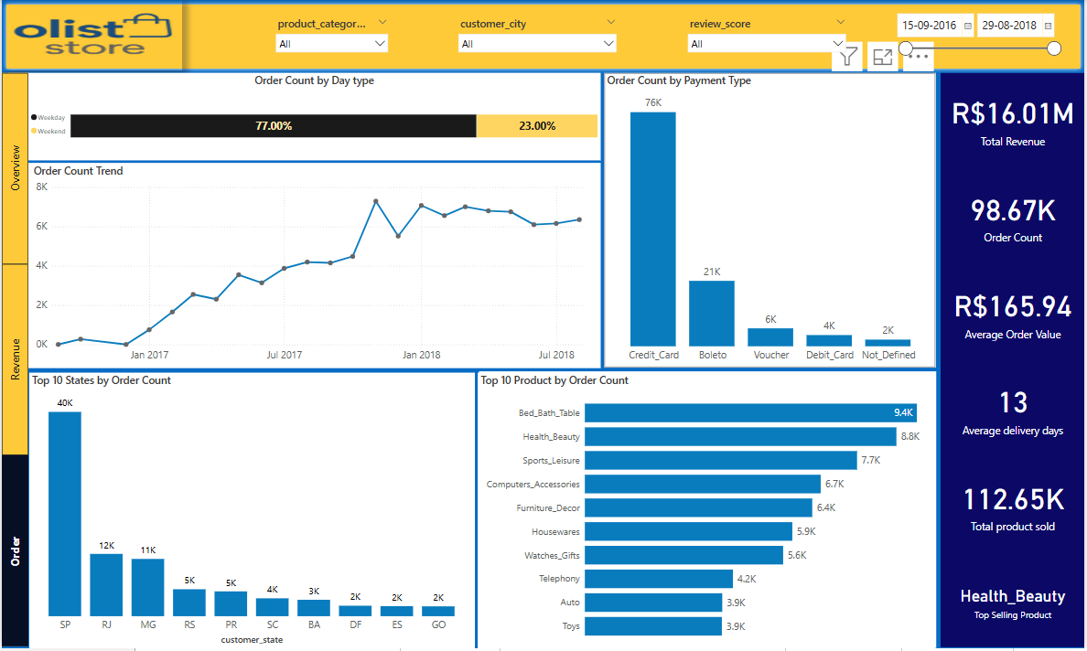
Power Bi – Olist Store Dashboard (Order’s)

Slide 8
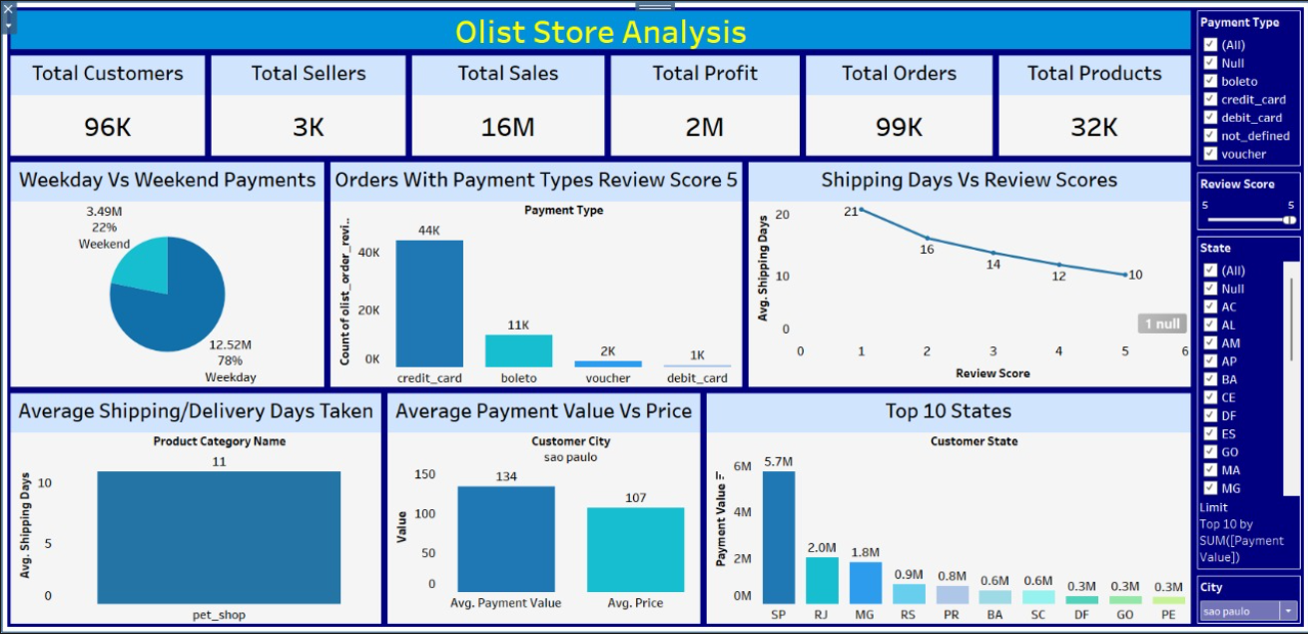
Tableau – Olist Store Dashboard

Slide 9
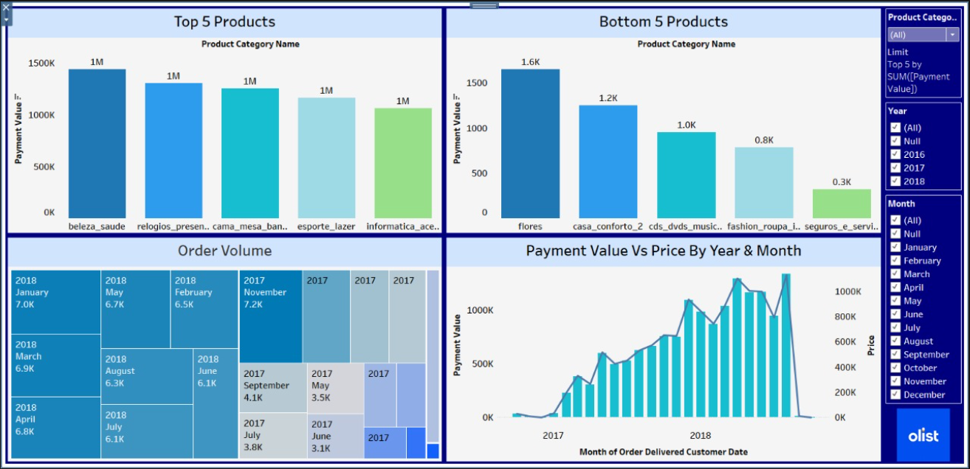
Tableau – Olist Store Graph’s

Slide 10
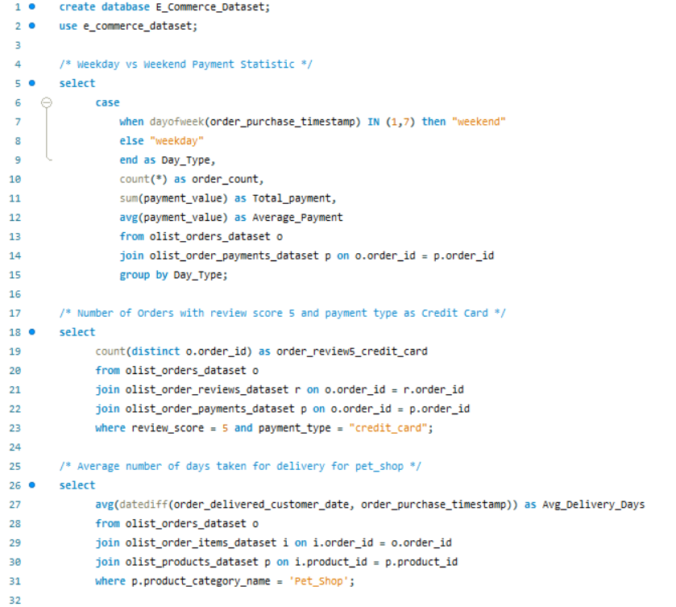
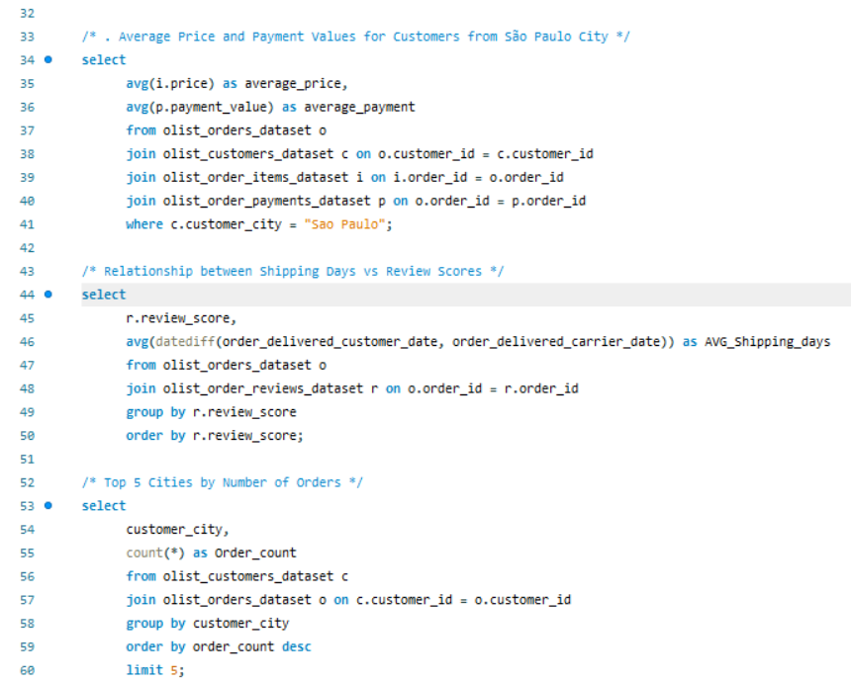
SQL Query – Olist Store

Slide 11
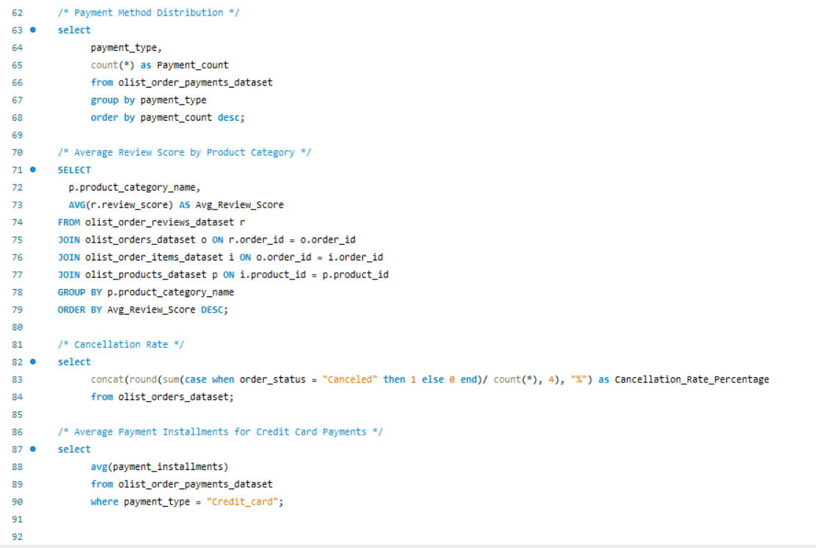
SQL Query – Olist Store

Slide 12
Olist Store Project Overview
Datasets Used (9 Total)
Dataset | Rows | Columns
Customers | 99,441 | 5
Geolocation | 1,000,163 | 5
Order Items | 112,650 | 7
Order Payments | 103,886 | 5
Order Reviews | 99,224 | 7
Orders | 99,441 | 8
Products | 32,951 | 9
Sellers | 3,095 | 4
Product Category Translation | 71 | 2

Slide 13
Olist Store Project Overview
Key Fields & Analytical Focus
Main Analysis Areas:
Order Lifecycle: Purchase to delivery timelines (e.g., order_purchase_timestamp, order_delivered_customer_date).
Customer Data: Location (city, state), zip code prefix.
Payments: Types, installment count, payment value.
Products & Sellers: Price, freight value, seller location.
Customer Feedback: Review scores, comments.
Key Statistical Insights
Order Trends: Growth over time by month/year.
Payment Types: Most common is credit card; visible payment method distribution.
Shipping Insights: Delivery delays, average delivery days by category.
Customer Reviews: Review score distributions and trends.
Top Locations: Highest order volumes by cities and states.
Seller Spread: Distribution and performance metrics.
Additional Insights & Overall Stats
Top 5 & Bottom 5 Products: Based on sales and frequency.
Customer & Seller Counts: Total customers, sellers, orders, sales, and profits tracked.
Regional Performance: Identified top states with high sales volumes.
Time-Based Trends: Payment value vs price trends by year/month.
Order Volumes & Deliveries: Clear increase in order volume and successful deliveries over time.

Slide 14
Olist Store Project Overview
Tool Usage & Workflow
Excel:
Data cleaning using Power Query.
Built KPIs via pivot tables and charts.
Created a summary dashboard with descriptive stats.
Power BI:
Imported cleaned data.
Used DAX for KPIs and measures.
Built interactive dashboards and slicers for drill-downs.
Tableau:
Used similar process as Power BI.
Added calculated fields for visual insights.
Created story dashboards for data narrative.
SQL:
Wrote queries to extract KPIs and summaries from raw datasets.
Joined tables and calculated delivery durations, review trends, etc.
Key Observations from KPI’s
Weekday vs Weekend Orders:
77% of purchases occur on weekdays, only 23% on weekends.
Review Score & Payment Type:
~44K–45K orders with review score 5 and payment type “credit card” — highest among all combos.
Pet Shop Delivery Time:
Average delivery duration is 11–12 days — considered efficient.
Sao Paulo Spending Insight:
Avg. payment value = 134, avg. product price = 107.
Delivery vs Review Score Correlation:
As review scores increase, average shipping days decrease (e.g., score 5 → ~9 days, score 1 → ~15+ days).

Slide 15
Thankyou For Watching
I hope this analysis provided valuable insights into the Olist Store e-commerce data.

